Slide 1
Welcome to Data Science!

Slide 2
About me
Teaching Experience
Rochester Museum and Science Center
University of Texas at Arlington
Industry Experience
Productive Rehabilitation Institute in Dallas for Ergonomics
U.S. Army Public Health Center
Curriculum Writing Experience
Rewritten most of your modules here!
Textbook chapters
Training manuals and presentations

Slide 3
Expectations
Approximately 20 hours per week in your course
Login at least 4 days per week
Deadlines:
Wednesday / Saturday – Bethel / Belhaven students
Wednesday / Sunday – all other students
Communicate

Slide 4
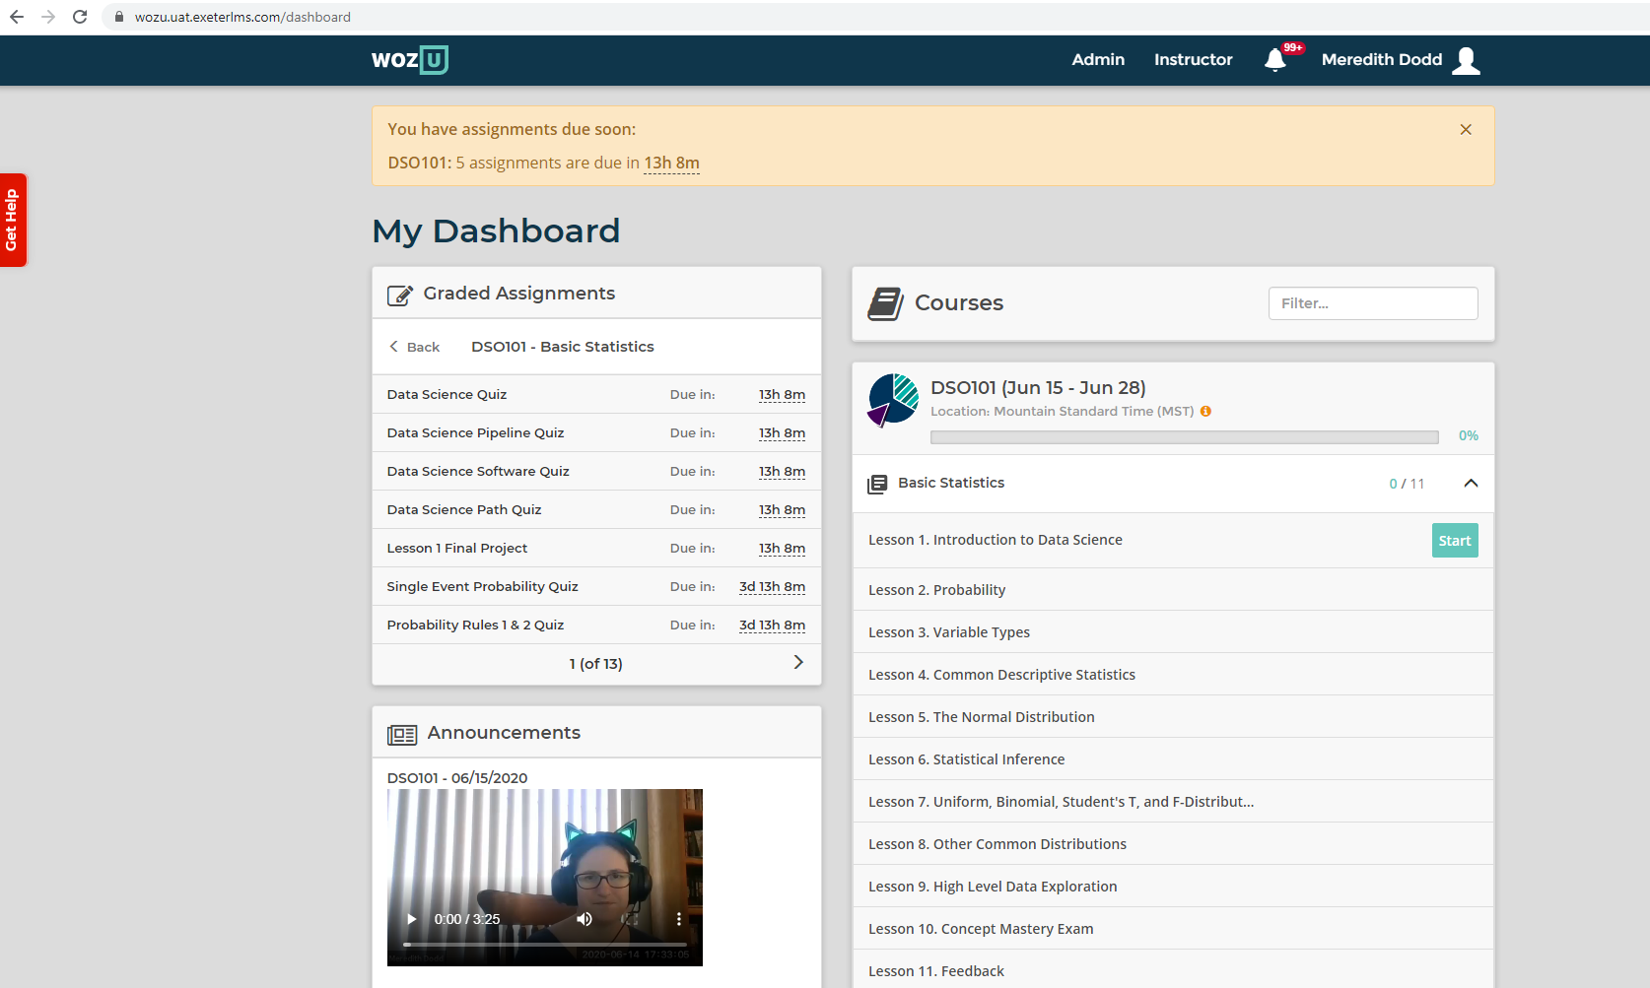

Your Dashboard

Slide 5
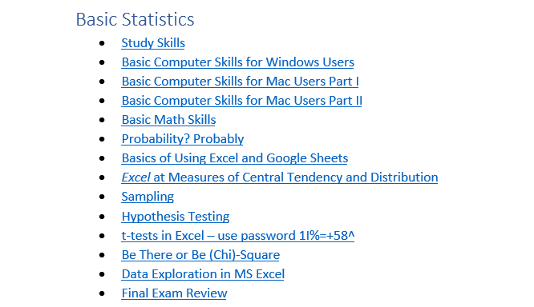
Workshops
Recorded links: https://repo.exeterlms.com/documents/V2/DataScience/WorkshopList.doc
More workshops available than live
Go at your own pace
Ctrl + click to open

Slide 6
Screenshots & Zipping Files
Covered in the Basic Computer Skills workshops
One for Mac, one for Windows

Slide 7
Helpful Slack Tips

Slide 8
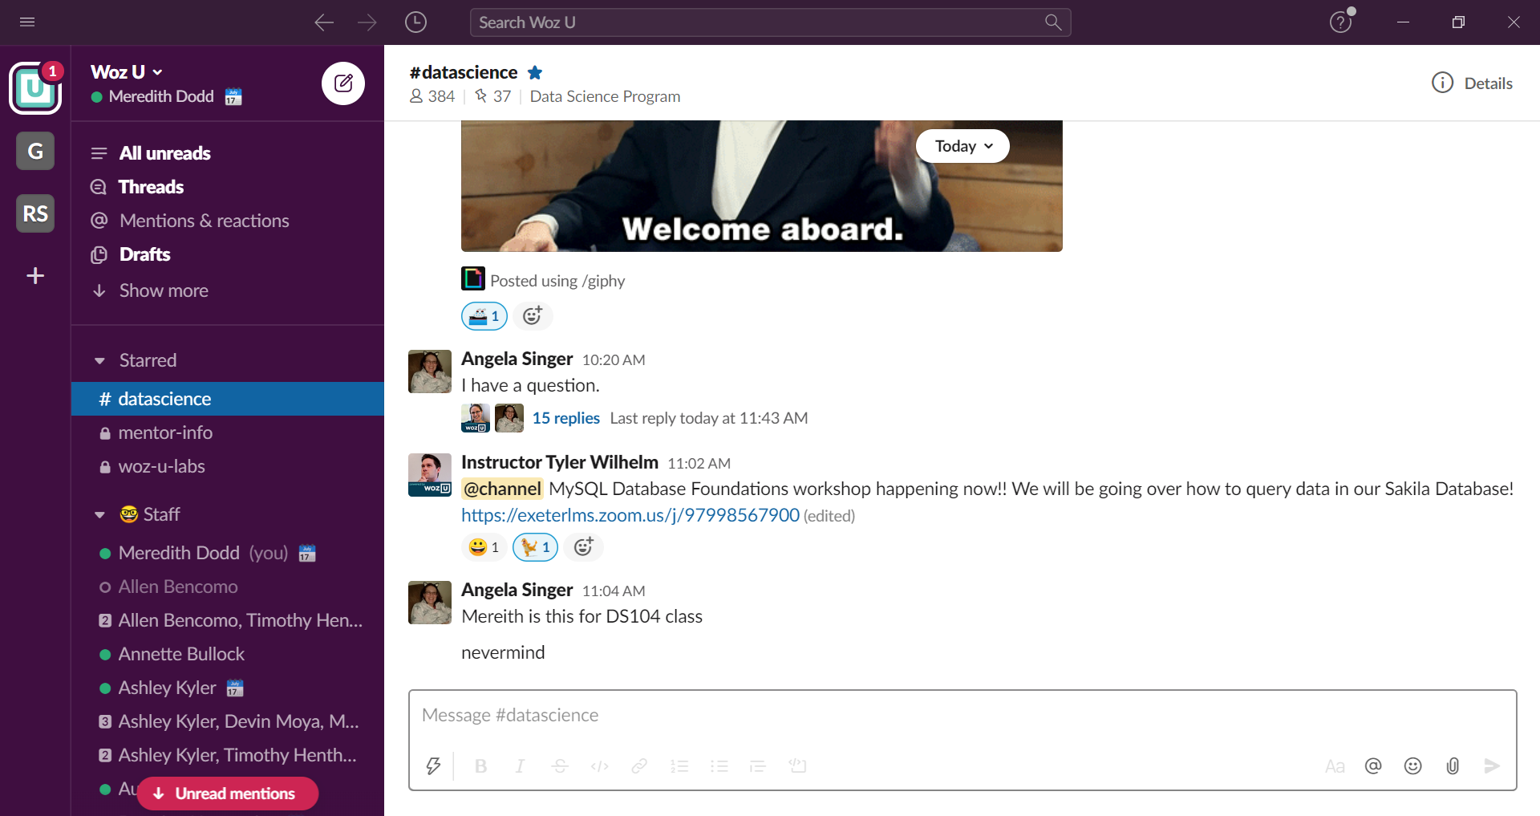
#datascience
Course Announcements
Ask questions
Share resources
@mentors will tag staff

Slide 9
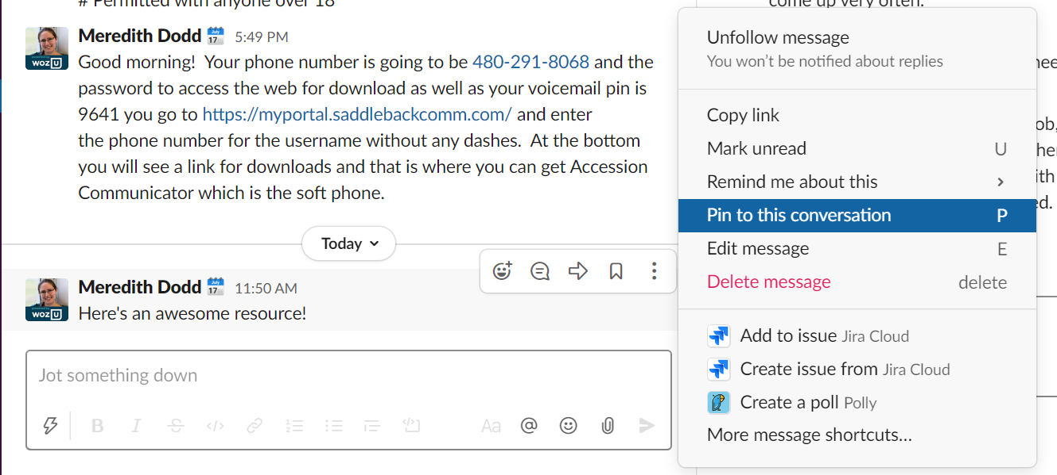
Pinned Items & Reminders
Right click on a message for awesomeness!
View pinned Items with Pin at Top Left

Slide 10
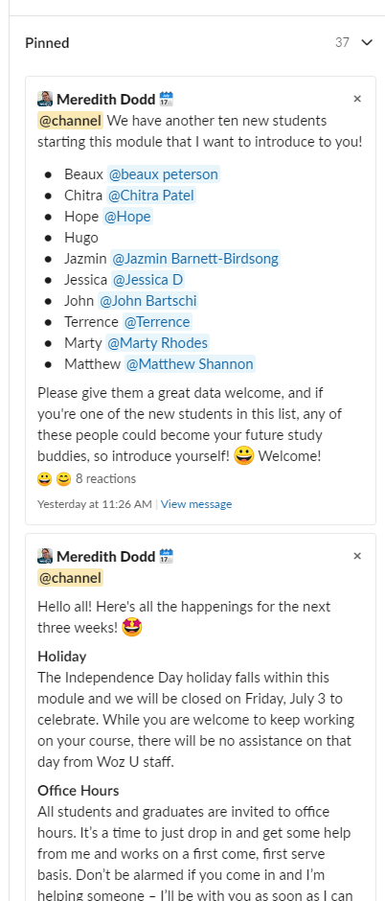
Pinned: Module Announcements Introductions

Slide 11
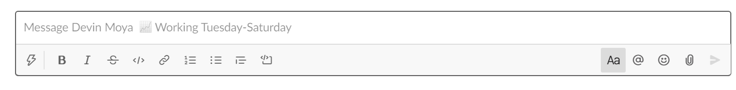
Additional Slack Stuff
Access on Computer to send Screenshots
Can attach files (drag and drop)
Green light – online
Calendar – in a meeting
See work days when you message us

Slide 12
Data Science

Slide 13
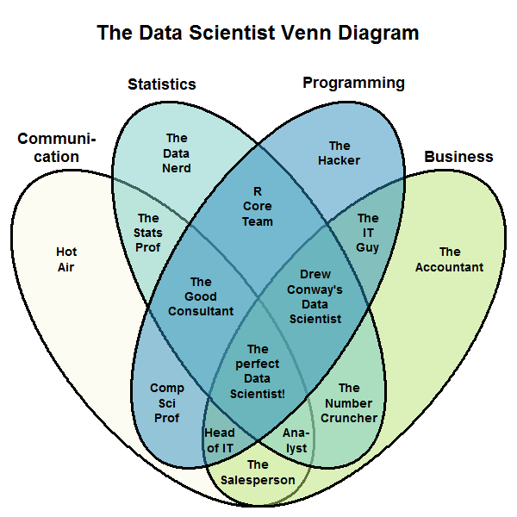
What is Data Science?
Combines statistics, programming, information science, and business acumen
Make data actionable!

Slide 14
Why is Data Science the Top Job?
EVERYONE needs data scientists! Not just tech companies
Not enough data scientists to go around!
Organizations face enormous challenges organizing data

Slide 15
In what Industries are Data Scientists Working?
Biotechnology
Energy
Transportation
Telecommunications
Social Media
Finance
Insurance
Healthcare and pharmaceuticals
Internet

Slide 16
About this Course

Slide 17
Your Journey through This Course
Basic Statistics
Statistical Programming in R
Programming Foundations in Python
Databases
Data Wrangling and Visualization
Intermediate Statistics
Machine Learning and Modeling
Intro to Big Data
Metrics and Data Processing, Project Management
Group Project
All are 3 week modules
6 week finale

Slide 18
Your Journey through This Course
Basic Statistics
Statistical Programming in R
Programming Foundations in Python
Databases
Data Wrangling and Visualization
Intermediate Statistics
Machine Learning and Modeling
Intro to Big Data
Metrics and Data Processing, Project Management
Group Project
Taken in this order
Completed in any order

Slide 19
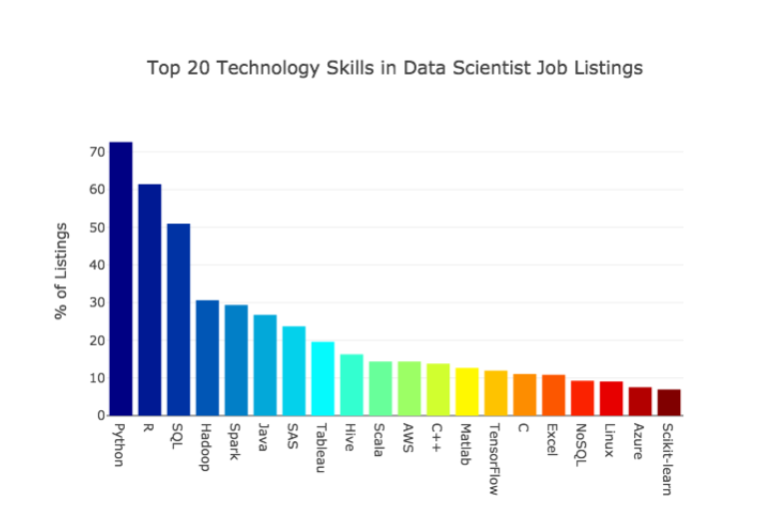
What Major Software Programs will you learn?
√
√
√
√
√
√
√
√
√
√
√
√

Slide 20
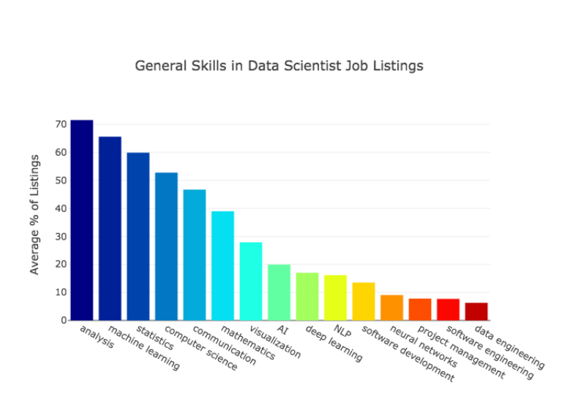
What Data Science Skills will you learn?
√
√
√
√
√
√
√
√

Slide 21
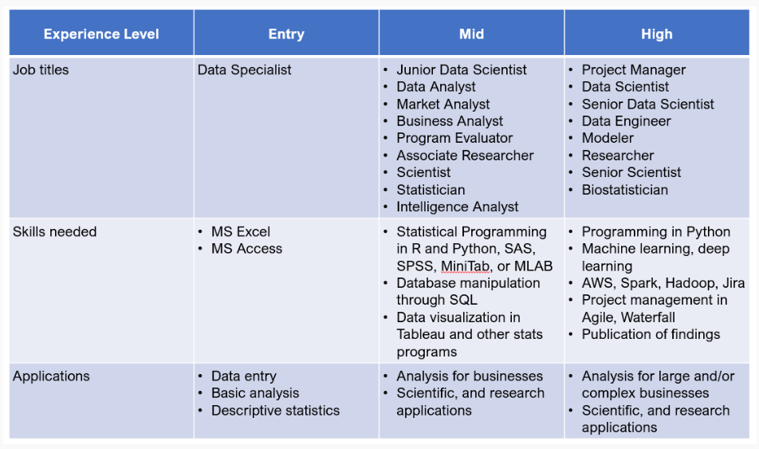
What can I do when I graduate?

Slide 22
Questions?

